Slide 1
Mood Detection from Facial Features and Recommendation System
Members:
60003190006 - Aryan Ringshia
60003190033 - Neil Desai
60003190048 – Shaurya Magar

Slide 2
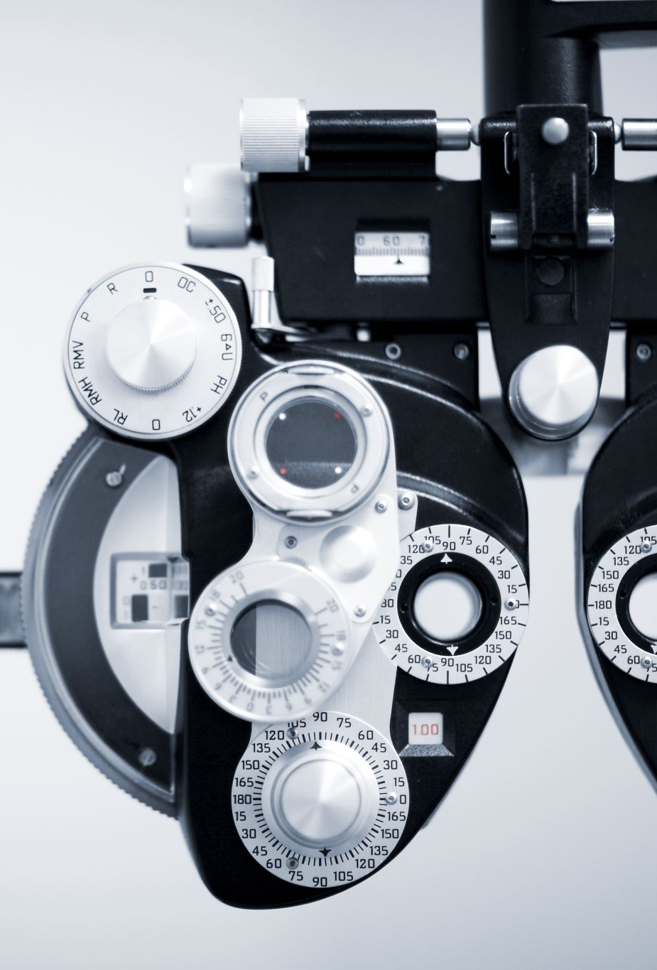
Overview
Recommendation engines are a subclass of machine learning which generally deal with ranking or rating products / users - systems designed to recommend things to user based on many different factors
Human emotions can be broadly classified as: fear, disgust, anger, surprise, sad, happy and neutral
Benefits users in finding items of their interest - assists a user regarding which music/movie they should listen/watch that would reduce their stress levels
Identity products that are most relevant to users.
Personalized content.

Slide 3
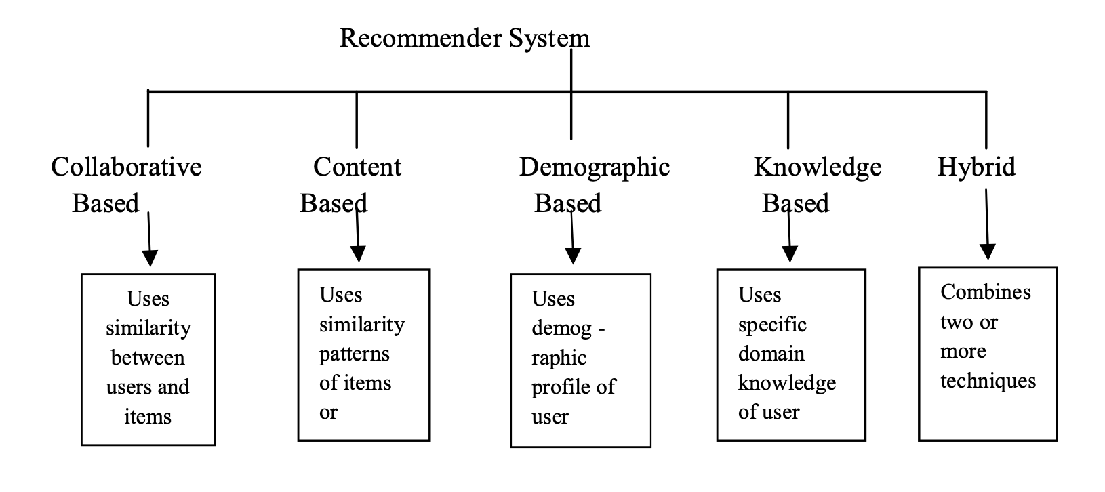
Motivation
Studies in consumer research indicate that mood states have effects on user behaviors and evaluation
However, the majority of these and other approaches have focused using on ratings information for recommendation, while ratings are important, what is missing from the most of the recommendation approaches is context – mood/emotion
Main objective of music/movie recommendation system: provide suggestions to users that fit their preferences and current emotional or mental state.

Slide 4
Our Approach
User would not have to waste any time in searching or to look up for movies and the best movie matching the user’s mood is detected, and songs would be shown to the user according to their mood.
Emotion Extraction
Image captured
Mood detection
Recommendation - appropriate movie matching the user’s requirement provided.

Slide 5
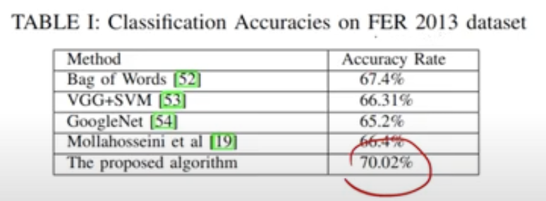
Emotion Extraction Module
Facial expression recognition used for Mood Detection
System captures image of user using camera/webcam
Image segmentation and image processing techniques used to extract features from face of target human being - detect emotion that person is trying to express
Position of facial landmarks are extracted from image based on the knowledge from training set and coordinates of new facial landmarks that are detected returned.
Dataset - FER-2013 - 7 categories (0=Angry, 1=Disgust, 2=Fear, 3=Happy, 4=Sad, 5=Surprise, 6=Neutral)

Slide 6
Recommendation
The system will search for like-minded users who have similar emotion profiles and recommend movies.
Future scope - System can be extended to give Music recommendations too.
Combination/Hybrid of 2 types of recommendation system i.e. content based and collaborative filtering offers more power for recommender system.
Dataset: MovieLens - describe ratings and free-text tagging activities from MovieLens, a movie recommendation service. It contains 20000263 ratings and 465564 tag applications across 27278 movies. Users were selected at random for inclusion. All selected users had rated at least 20 movies.

Slide 7
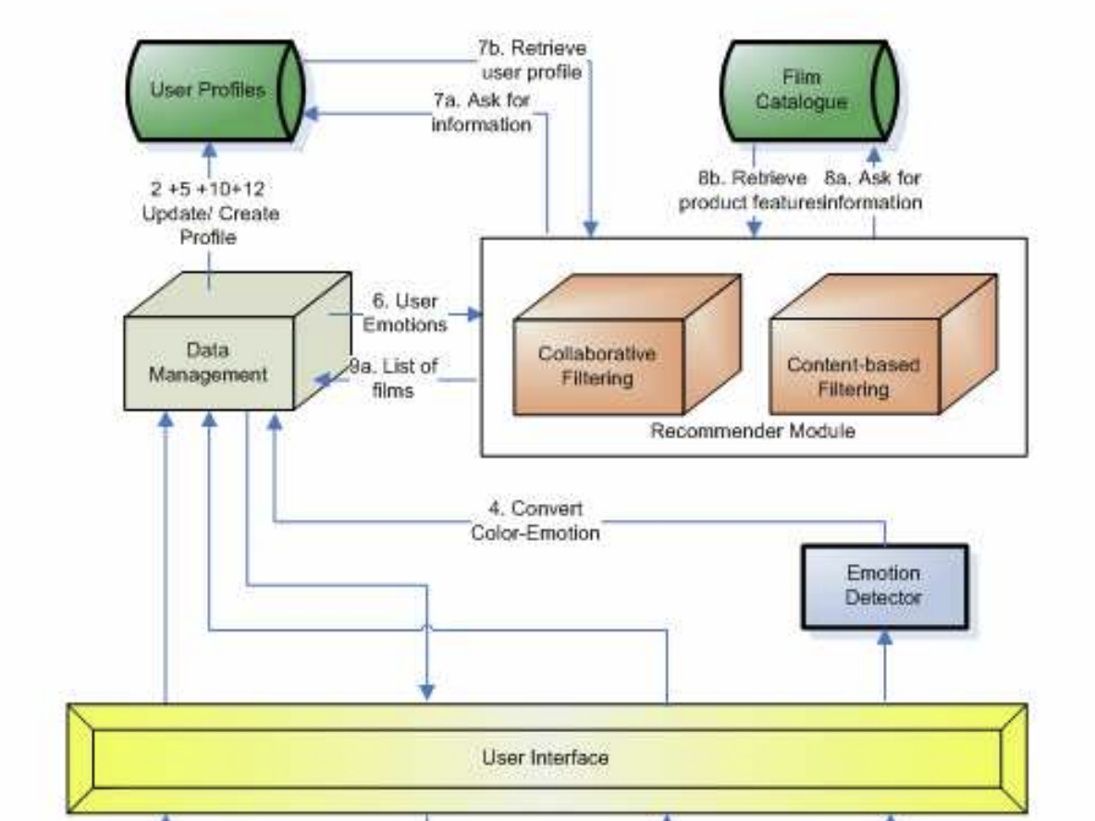
Architecture
Cascade hybridization - Recommendation by 1 technique generated - results are refined or filtered by another recommendation technique
Another option is using weighted hybridization to combine lists.
Content-based filtering - system finds similarity between products based on context/description - cosine similarity to quantify the similarities between movies.
User-User collaborative filtering - assumes if different users rate movie items similarly have similar behavior.
Mood used to pick genre and top-N films list recommended to user.

Slide 8
For Collaborative Filtering -
Singular Value Decomposition (SVD)
Matrix factorization - dimensionality reduction technique
Uses a matrix structure of ratings where each row represents a user, and each column represents an item
For Content Based Filtering -
System finds the similarity between movies based on its context or description
2 types of data used - user vector, item vector - cosine similarity
tf-idf vectorizer - similar tf-idf vectors using cosine similarity

Slide 9
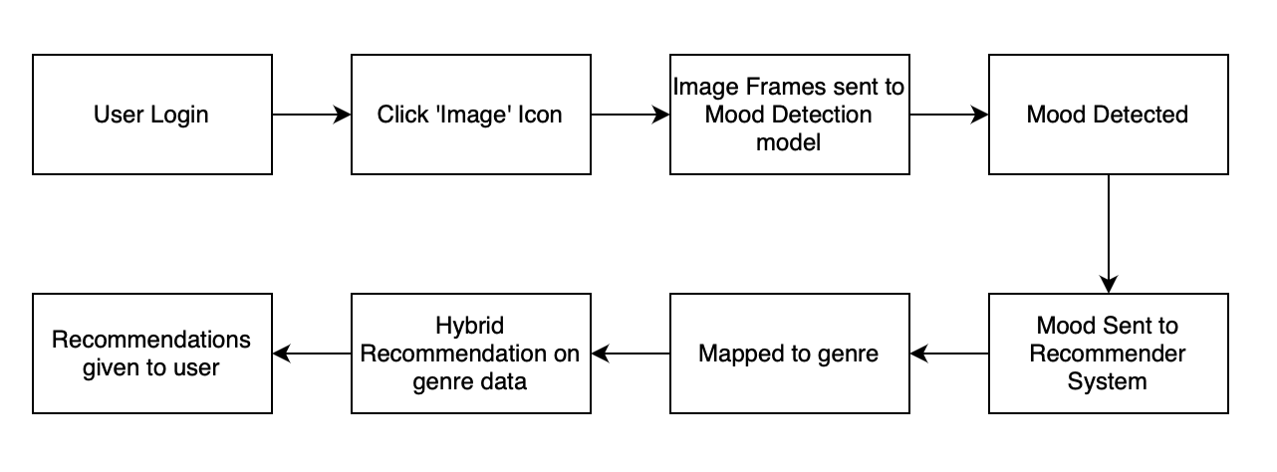
System Process Flow

Slide 10
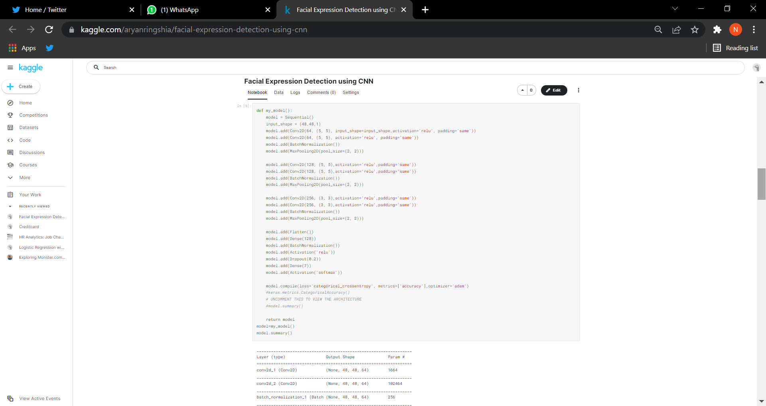
Implementation
Mood Detection module: Complete (Dataset: FER-2013, 7 categories (0=Angry, 1=Disgust, 2=Fear, 3=Happy, 4=Sad, 5=Surprise, 6=Neutral)
Code Snippet:
1) Model

Slide 11
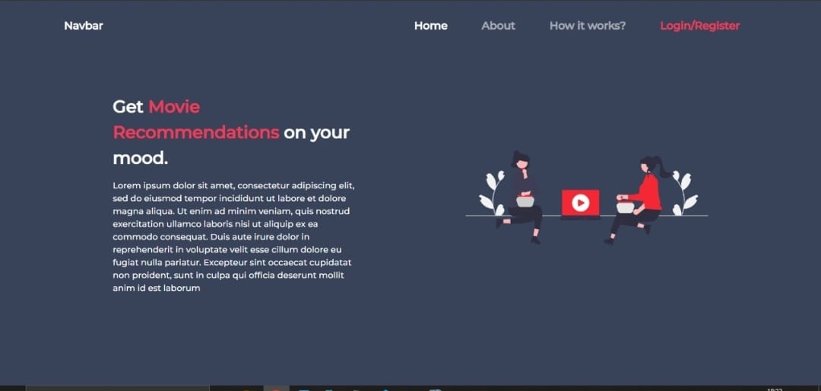
Implementation
GUI

Slide 12
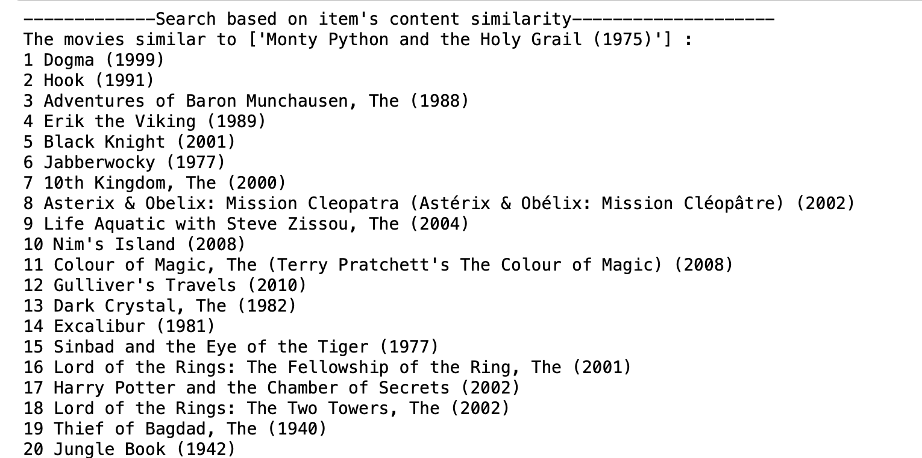
Implementation Continued
3) Recommendation Module:

Slide 13
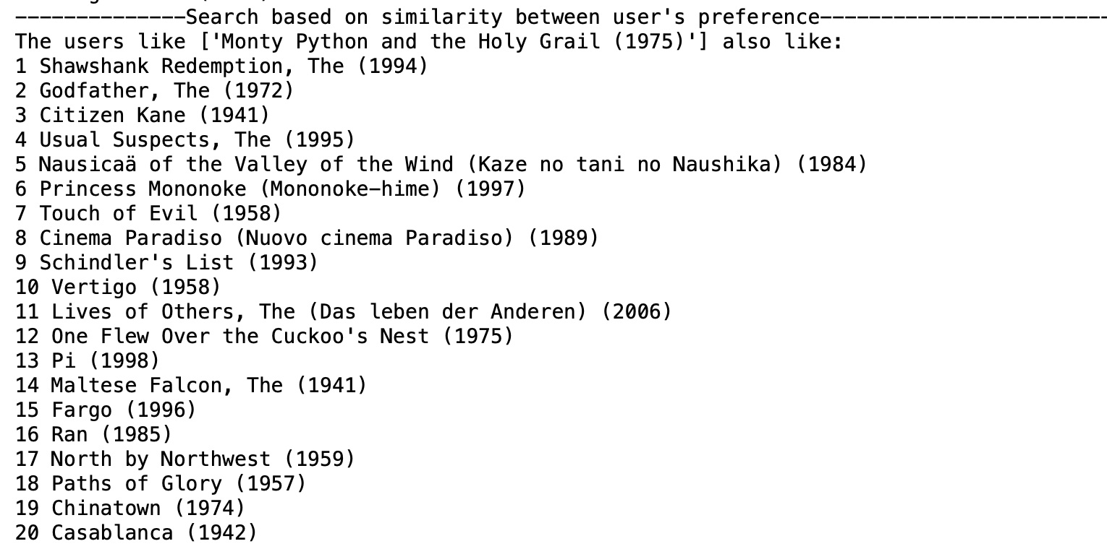
Implementation Continued
4) Recommendation Module:

Slide 14
Thank You

